Slide 1
Anomly detection with isolation forests
Which elements are few and different?
Terence Parr University of San Francisco
Project link: https://github.com/parrt/msds689/blob/master/projects/iforest/iforest.md

Slide 2
Anomaly detection
Applications include detecting network attacks, financial fraud, unusual changes in stock prices or other timeseries / signals
Either focus on what’s normal and look for “nonnormal” e.g., use kernel density estimates and look for elements > 4 sigma
Or, focus on the unusual, which is what isolation forests do

Slide 3
Random-split isolation in 1D
To isolate x takes many partitions (splits at a, b, c)
This leads to path length 3

Slide 4
Random split on feature w/high kurtosis
x has path length 1
“Anomalies are more susceptible to isolation and hence have short path lengths.” – Liu et al

Slide 5
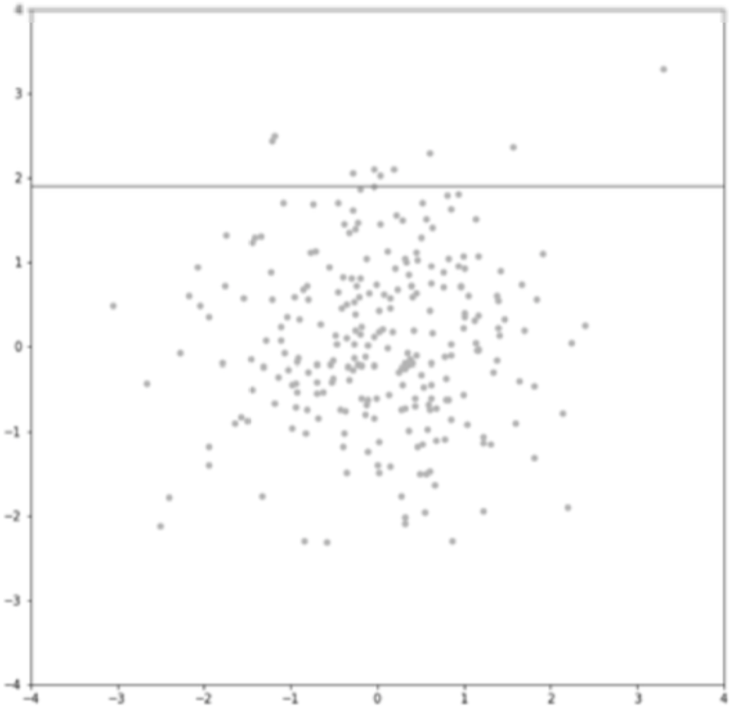
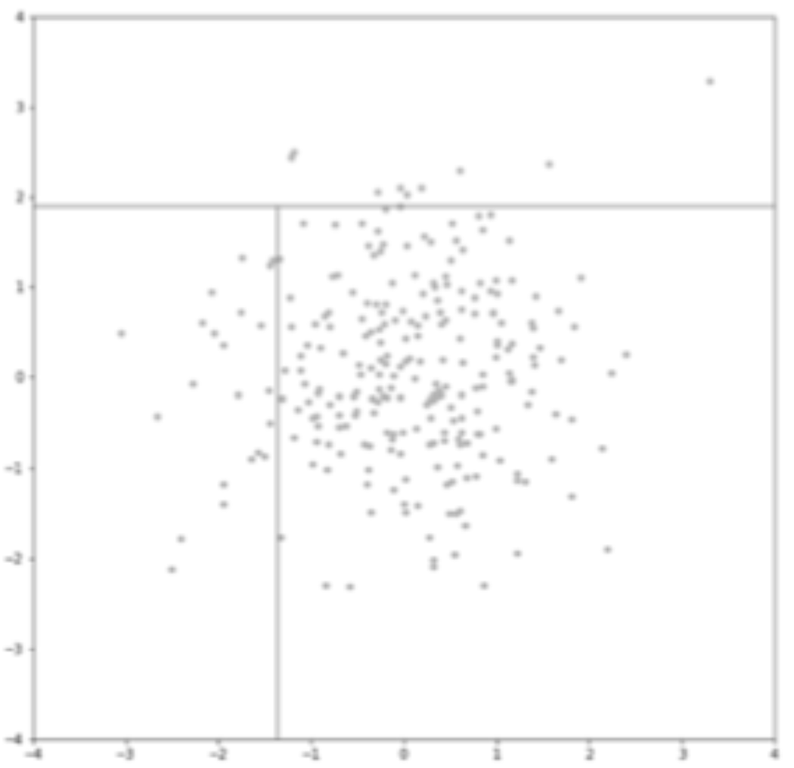
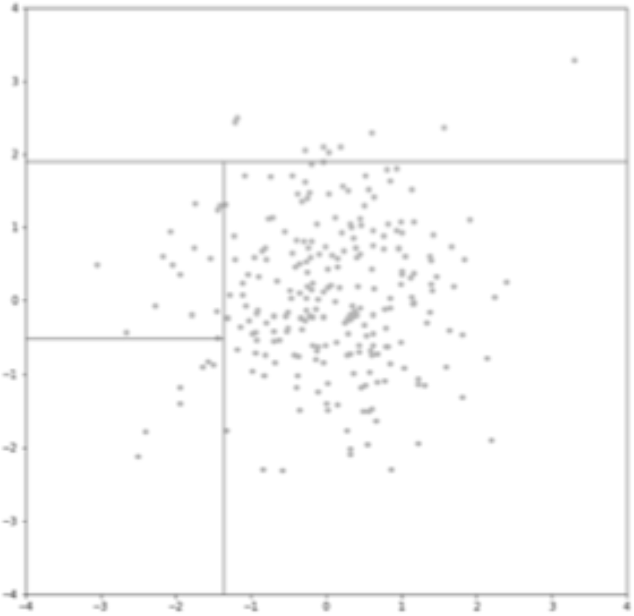
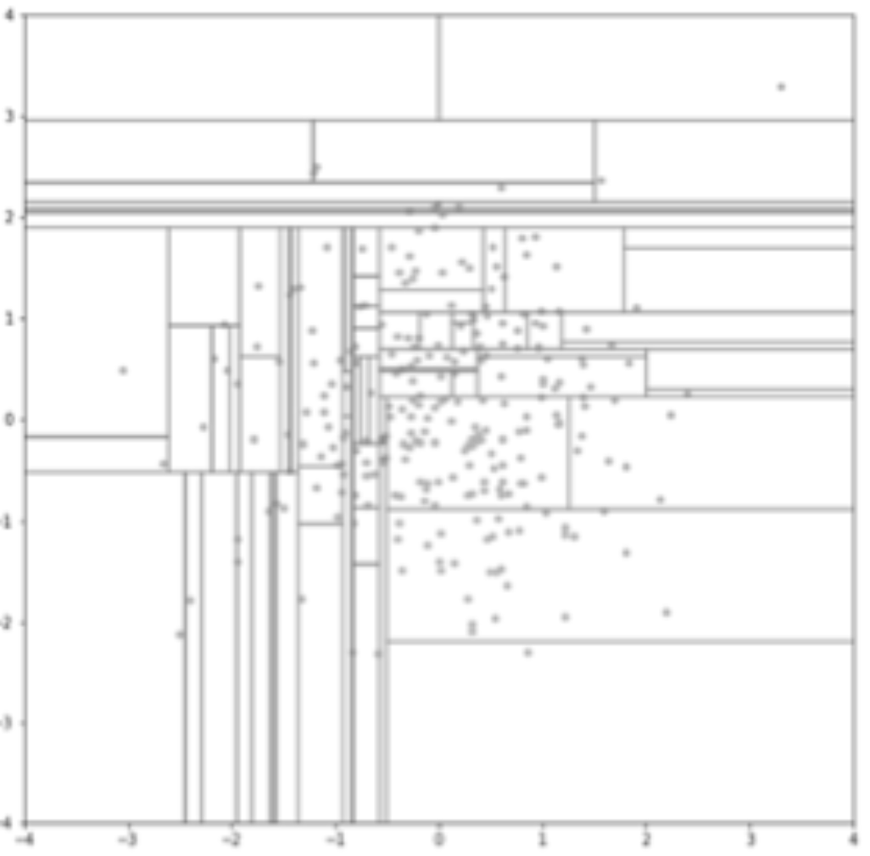
Random split isolation in 2D: [X1 X2]
X2
X1
X1
X1
X1
Images: http://www.ncsa.illinois.edu/Conferences/LSST18/assets/pdfs/hariri_forest.pdf

Slide 6
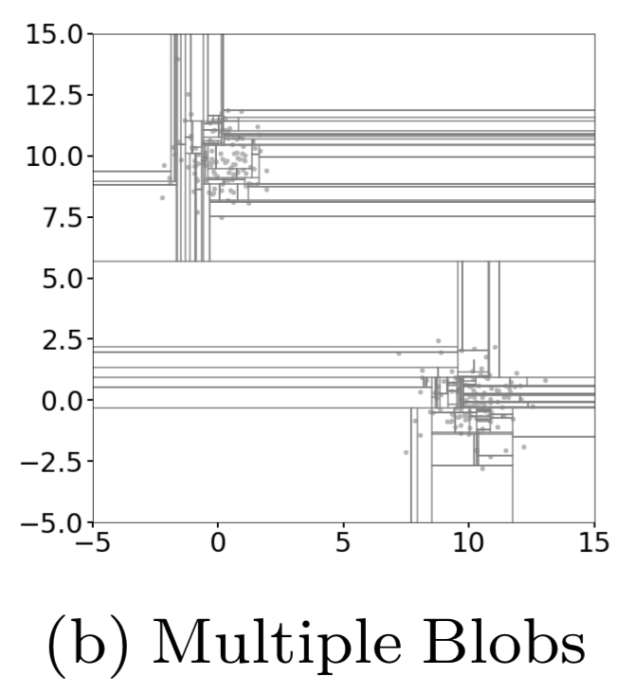
Works for multimodal data too

Slide 7
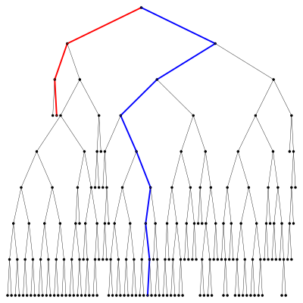
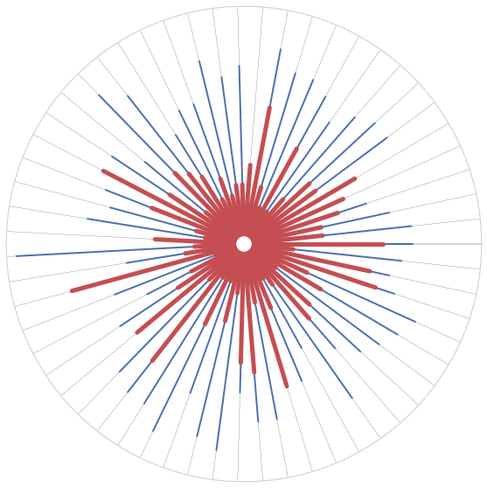
Forest of isolation trees
Score for x is inversely related to depth of leaf containing x
Average score across forest to get anomaly score
Tree
Forest
Images from Hariri et al: https://arxiv.org/abs/1811.02141

Slide 8
Scoring: sigmoid on normalized path length
h(i) ~= ln(i) + 0.5772156649
Credit card data

Slide 9
Tree construction
From tiny subsample of all X training data, partition based upon random Xi feature and random split point between min(Xi) and max(Xi)

Slide 10
Computing path length
Recursively count levels, e, to node containing x
If |X|>1 for leaf, we need to estimate depth using c(|X|) for samples X in leaf

